Slide 1
COMP 3400
Week 13 – Monday

Slide 2
Last time
What did we talk about last time?
Parallelism vs. concurrency
Task parallelism
Data parallelism
Parallel algorithmic strategies
Embarrassingly parallel
Divide and conquer
Pipelines
Parallel implementation strategies
Fork/join
Map/reduce
Manager/worker

Slide 3
Questions?

Slide 4
Assignment 7

Slide 5
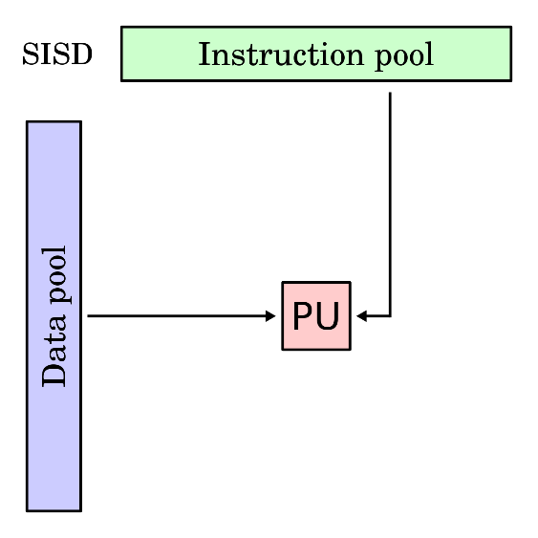
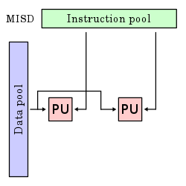
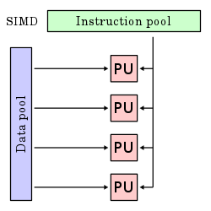
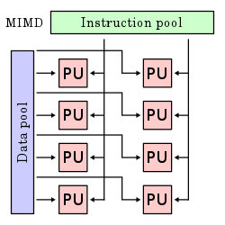
Flynn's taxonomy
Flynn's taxonomy divides hardware into how they can deal with multiple instructions and multiple pieces of data
Single Instruction Single Data (SISD) is sequential processing of one piece of data with one instruction
Single Instruction Multiple Data (SIMD) is processing several pieces of data with the same instruction, like the vector processing done in graphics cards
Multiple Instruction Single Data (MISD) isn't used commonly, but it can allow for fault-tolerance because different instructions are executed in parallel on the same data
Multiple Instruction Multiple Data (MIMD) is processing different instructions on different data at the same time
Images from Wikipedia

Slide 6
Limits of Parallelism

Slide 7
Speedup
Speedup is how much faster a parallel solution is compared to a sequential one
The formula is $\frac{T_{sequential}}{T_{parallel}}$
$T_{sequential}$ is the amount of time the sequential solution takes
$T_{parallel}$ is the amount of time the parallel solution takes
Thus, if a sequential solution to a problem takes 100 seconds, and the parallel solution takes 50 seconds, the speedup is 2

Slide 8
Limits of parallelism
The study of parallel processing is, unfortunately, filled with bad news
A parallel program running on n processors can never run more than n times faster than a well-written program for 1 processor
Usually, running a parallel program on n processors is nowhere close to running n times faster
What is called linear speed-up

Slide 9
Amdahl's Law and strong scaling
What if you had 16 cores? Or 1,000 cores? Or a million?
How much speedup can you get?
Some part of the program has to be executed sequentially
Reading input
Starting threads
Combining results
Amdahl's law says that the maximum speedup possible is $\frac{1}{\left(1−p\right)+\frac{p}{N}}$
$p$ is the fraction of a program that can be parallel
$N$ is the number of processors

Slide 10
Consequences of Amdahl's law
What if we had unlimited cores?
We can take the equation $\frac{1}{\left(1−p\right)+\frac{p}{N}}$ and plug in $∞$ for $N$
Doing so would mean, even with infinite cores, we could never have better speedup than $\frac{1}{\left(1−p\right)}$
Let's say that 90% of a program can be parallelized
What's the maximum possible speedup you can get?
$S=\frac{1}{\left(1−p\right)}=\frac{1}{\left(1−.9\right)}=\frac{1}{.1}=10$

Slide 11
Gustafson's Law and weak scaling
Unfortunately, Amdahl's Law makes the unrealistic assumption that there's no extra overhead for creating more threads
This assumption is called strong scaling
Gustafson's Law tries to take a more realistic approach by letting speedup be $S=1−p+sp$
$p$ is the percentage of work that can benefit from some improvement in execution (not just parallelism)
$s$ is the amount of improvement
In Gustafson's Law, speedup means how much more data can be processed in the same amount of time
This approach is called weak scaling

Slide 12
Timing in Distributed Environments

Slide 13
Timing in distributed environments
When working on a single computer, there's only one clock
Thus, multiple threads can use this clock to record events in a mutually consistent way
Like adding timestamps to log files
Distributed systems don't have a single, reliable clock
Each computer might have a slightly (or completely) different time
Clocks on each computer drift with respect to each other
These problems get worse as distance (and network delays) increase

Slide 14
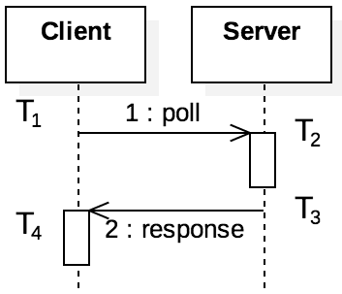
Clock synchronization
We can synchronize clocks based on a centralized server
A problem is that the time a message takes in the network is unpredictable
Network Time Protocol (NTP) is a protocol to do this:
Client sends a message at T₁
Server receives the message at T₂
Server replies at T₃
Client receives the message at T₄
Offset = $\frac{\left(T_{2}−T_{1}\right)+(T_{3}−T_{4})}{2}$
The offset is a measurement of the difference in times between the client and server
Delay = $\left(T_{4}−T_{1}\right)−(T_{3}−T_{2})$
The delay is a measurement of how long it takes for the messages to make a round trip
Algorithms process a number of offset and delay values to try to find the most accurate offset

Slide 15
Logical clocks
Large systems can't effectively use protocols like NTP
There are too many nodes to synchronize
The number of messages needed to synchronize becomes large
Logical clocks are an alternative system using messages to track the order of events
We're only trying to know the sequence of events, not their exact times

Slide 16
Lamport timestamps
Lamport timestamps are one way to implement logical clocks
Named after Leslie Lamport, of LaTeX fame
Each process keeps an internal counter of events that it sees
When a local event occurs, the counter is incremented
When a process sends or receives a message, it increments its counter
Messages have timestamps
When a process receives a message, it updates its internal counter to the message's timestamp if that timestamp is larger

Slide 17
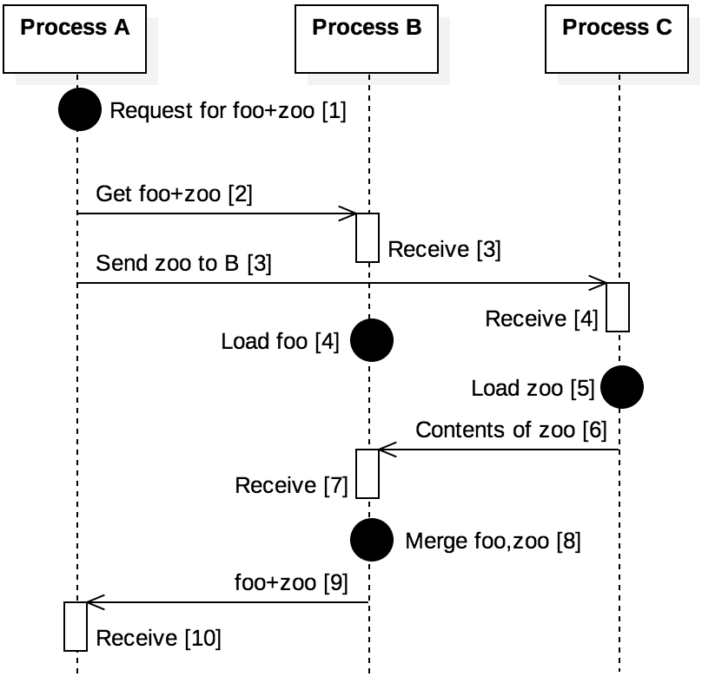
Example of Lamport timestamps
Consider a cloud system where requests can be made for files
Process A gets a request for the files "foo" merged with "zoo"
Timestamps are updated as messages flow through the system
Timestamps are purely relative and have no meaning to processes not involved in the exchanges

Slide 18
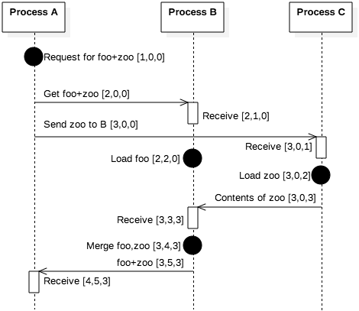
Vector clocks
Lamport timestamps only give indirect information about the state of other processes
Vector clocks extend the idea of Lamport timestamps by making every process keep a counter for every process
When a message from one process arrives, the receiving process can update all of its counters based on whatever is larger
Vector clocks give much more information about how many events have been experienced by other processes

Slide 19
Reliable Storage and Location

Slide 20
Reliable data storage
If you want to get a file from a web server, you can go to a URL and make an HTTP request
Unfortunately, if that server is down or unreachable, you can't get the file
For this reason, distributed systems are often used to store data
A key feature of distributed data storage is replication, keeping multiple copies of the same data
Replication avoids a single point of failure
If done correctly, replication can also do load balancing, improving performance by providing multiple sources for data

Slide 21
Google File System
The Google File System (GFS) is a distributed storage system
GFS was designed to store Google's internal data, like the data structures used for PageRank
Files are often large, so they're broken into chunks
Chunks are stored on chunkservers as regular files
A master server stores a table mapping file chunks to their locations

Slide 22
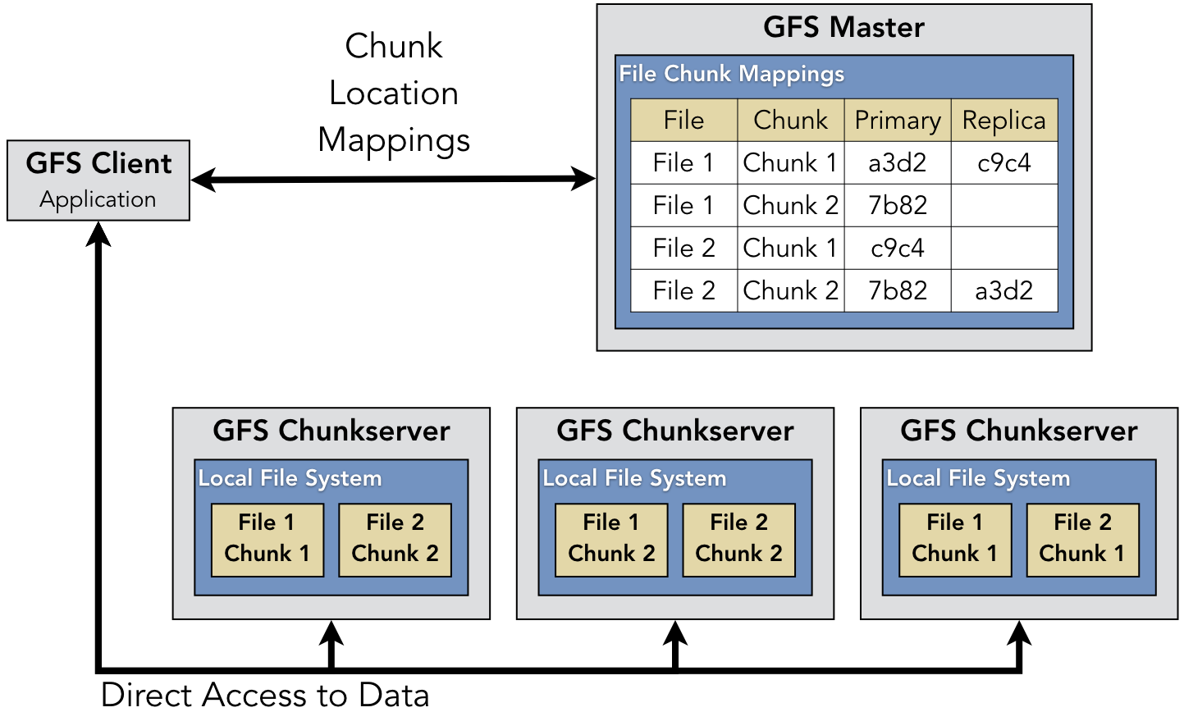
Illustration of GFS
Each chunk has a primary chunkserver as well as replicas
The chunks are identical, but the primary chunkserver is the only place where the chunk can be modified
It propagates changes to the other chunkservers
This redundancy makes writing to GFS slower, even though reading is relatively fast
The master server periodically sends messages to the chunkservers to get their current status

Slide 23
Distributed hash tables
GFS was designed by Google for its own purposes
It uses a central server
Servers keep information about each other
What if we have no idea what servers are going to be in the network?
Distributed hash tables (DHT) are an approach for mapping arbitrary objects to arbitrary servers
DHTs are a way to organize a peer-to-peer network to avoid query flooding

Slide 24
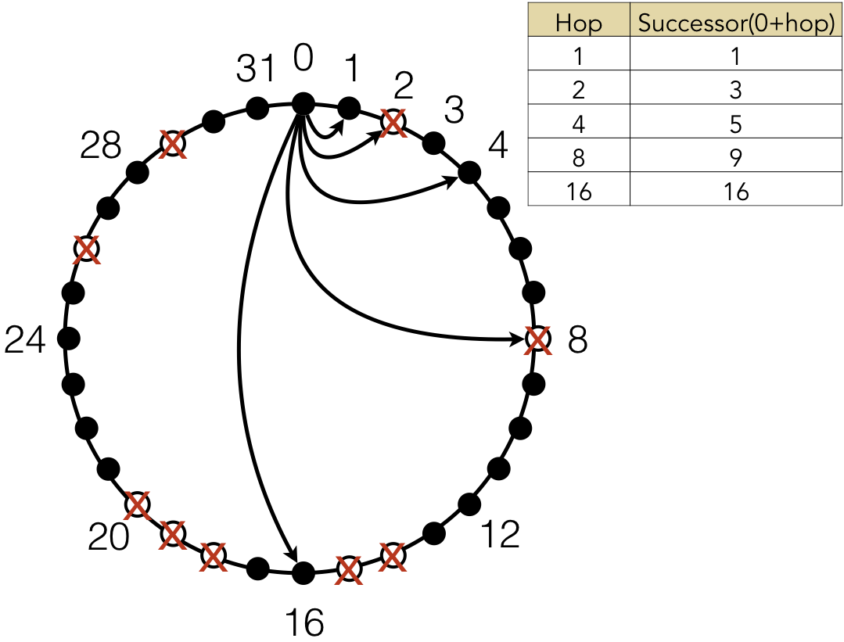
Chord DHT
Chord was one of the first algorithms for a DHT, introduced in 2001
Each node has a unique identifier (often its IP address) that's hashed to provide a location in a circle
If the hash is n bits long, the DHT can support up to 2^{n} nodes
Most locations in the circle are empty
Each node has a "finger table," tracking successor elements in increasing powers of 2 away on the circle
If the power of 2 node is missing, it tracks the next non-missing node
The example on the right is only for 2⁵ = 32 nodes

Slide 25
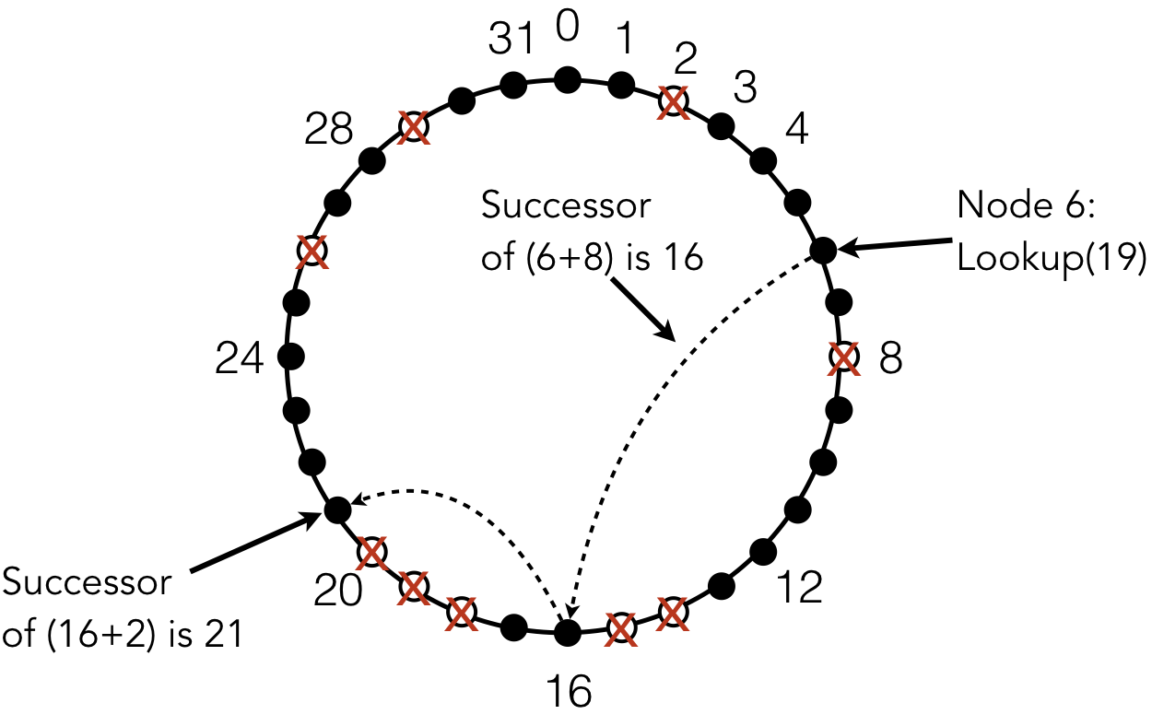
Files in Chord DHT
When a file is added, it's hashed
Whichever node has that hash value (or is its successor) is the location of that file
On the right, node 6 is looking for a file at location 19 (the successor of 18)
It looks at 6 + 8 = 14, which doesn't exist but has a successor of 16
Then it looks at 16 + 2 = 18, which doesn't exist but has a successor of 21
Node 21 is where the file is supposed to be
The details get a little more complex, but the practical result is that a file can be found with O(log n) requests, where n is the size of the network
Replication is done by caching files at nodes that were part of the lookup to find the file

Slide 26
Upcoming

Slide 27
Next time…
Finish reliable storage
Consensus in distributed systems
Blockchain

Slide 28
Reminders
Work on Assignment 7
Due Thursday
Read sections 9.6, 9.7, and 9.8

